Slide 1

InStep Internship
Final Presentation

Slide 2
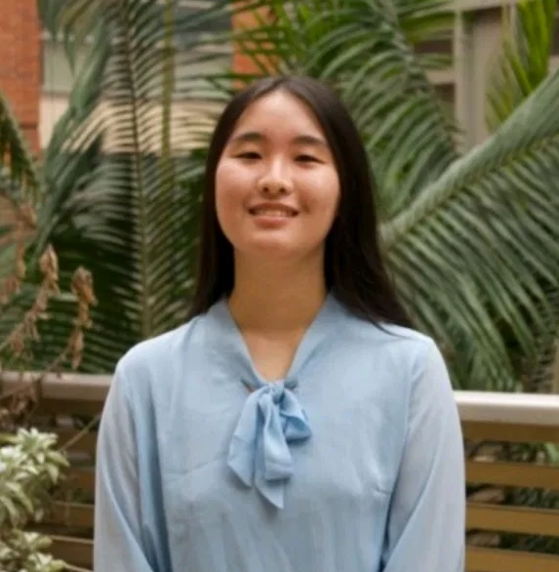
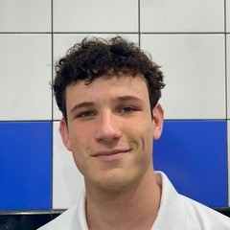
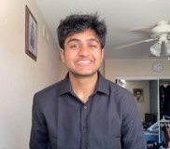
Meet the Team
Amanda Xu
Incoming 3rd year CS major @ UCLA
Paul Richard
Incoming 2nd year Robotics Masters
@ EPFL
Maan Patel
Incoming 2nd year CS major @ UCI

Slide 3
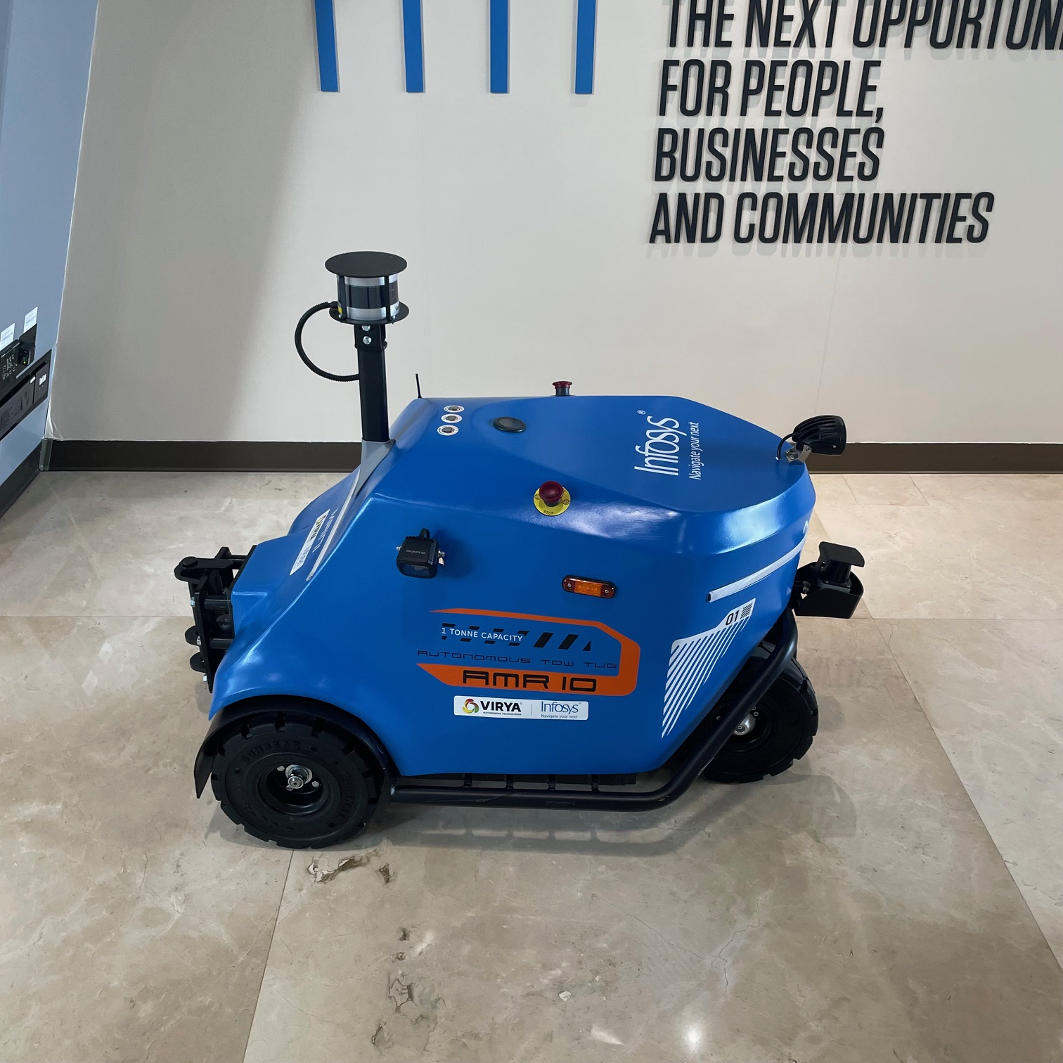

Project Overview
Objective: Create a Socially Aware Navigation Algorithm based on a camera input
From a camera detect the potential obstacles and plan a safe path to avoid any collision.
Use the camera every second or so to simulate the path.
In the meantime, only use the camera to deduce the speed of the obstacles
CAMERA
Notes:
amanda

Slide 4
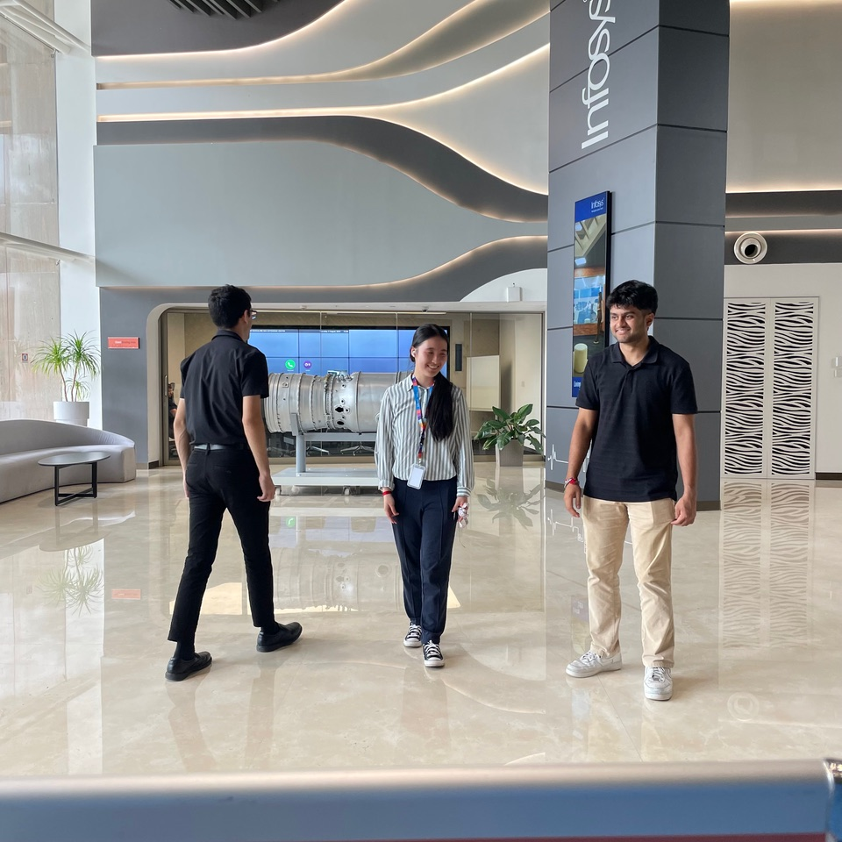
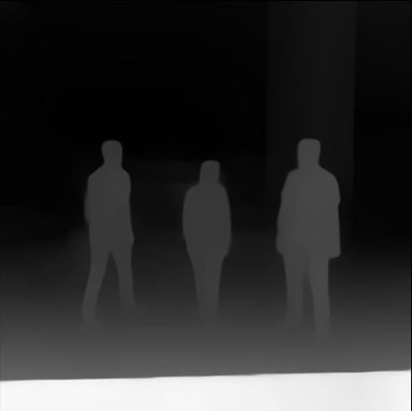
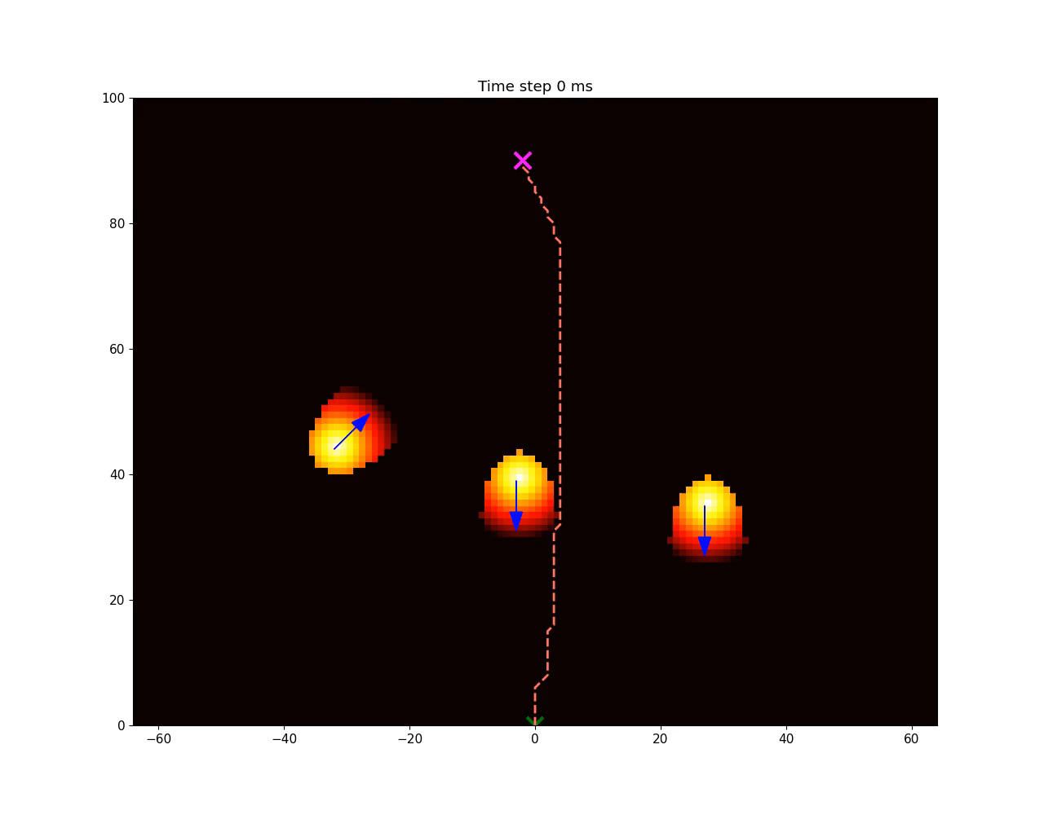
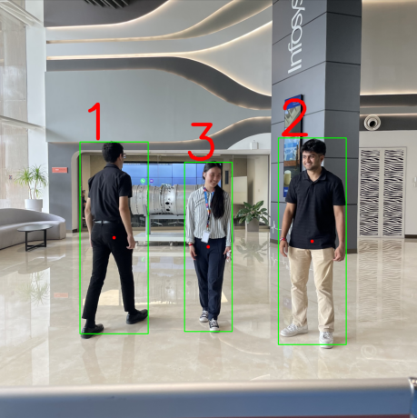
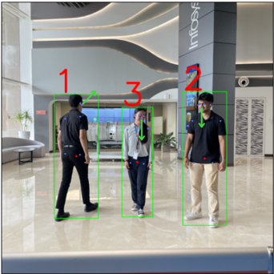
Project Overview
Input Image
Depth Image
Person detection
Orientation
Simulation
Notes:
Paul

Slide 5

1. Person Detection: Yolov5
Why Yolov5?
Optimal for accurate person detection and does it fast
Latest Yolo model that aligns with licensing guidelines
Notes:
maan

Slide 6
1. Person Detection: Yolov5
How does it work?
Pass in image to the Yolov5 model
Model outputs data of the bounds of where the person is and the confidence of the prediction
We can then draw a box based on the bounds given to us through the predictions
Notes:
maan

Slide 7
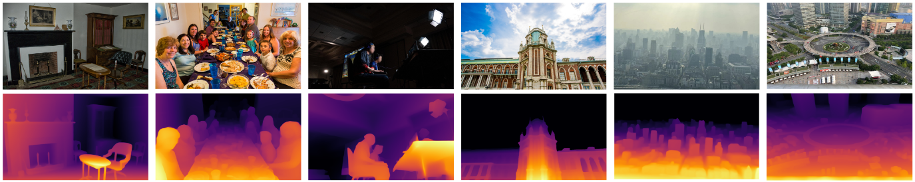
2. Depth Estimation: Depth Anything model
Motivations:
Negative aspect:
Deduce Depth from a 2d image
Works with any camera: low cost
No access to a depth camera dataset
High computational time
Low precision
Need a calibration step
BUT
Closest element is given a pixel value of 255, and subsequent pixel values are given a proportionally lower value
Notes:
paul

Slide 8
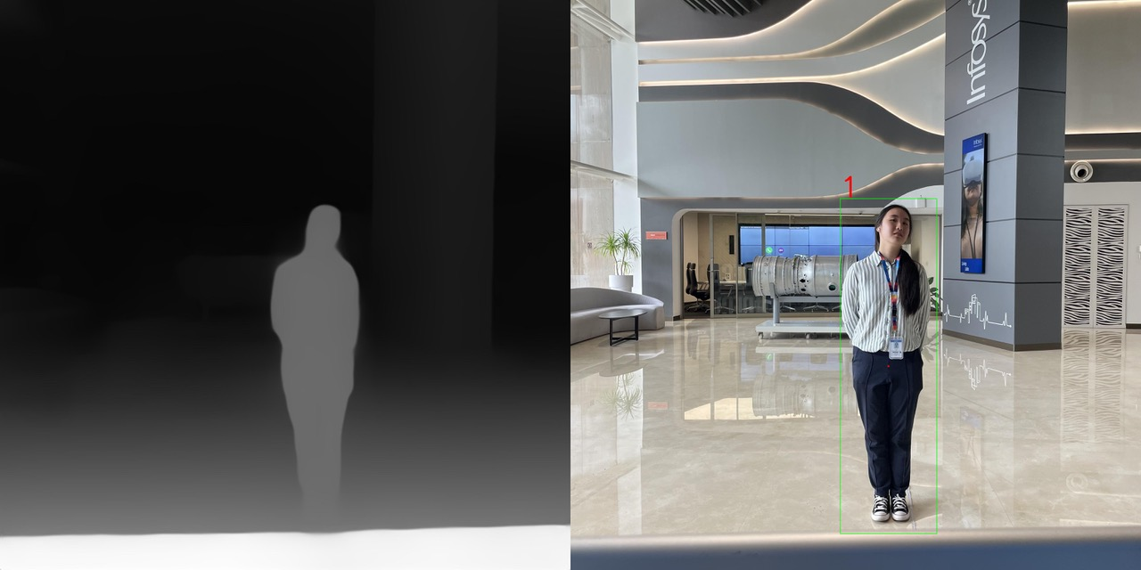
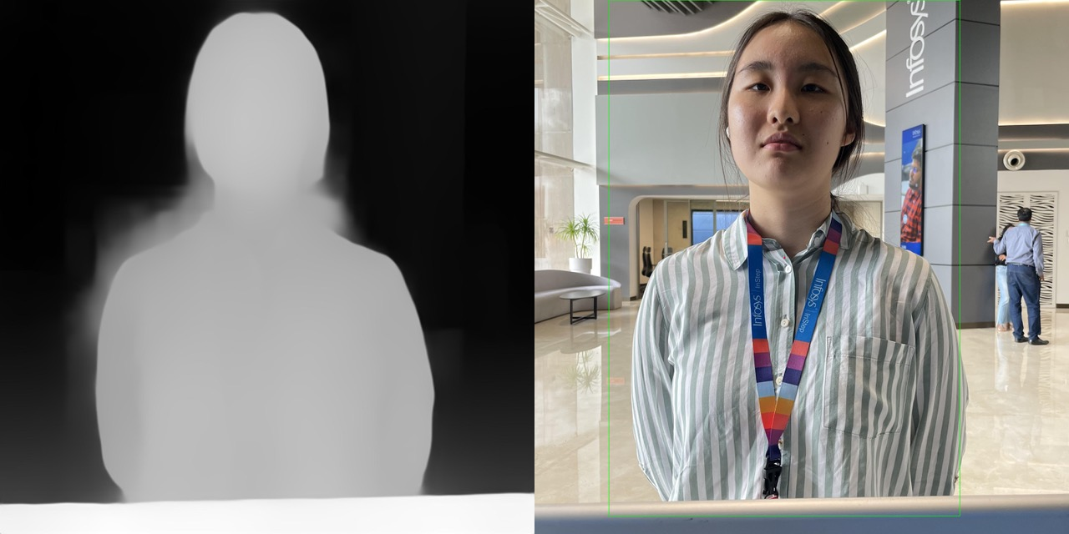
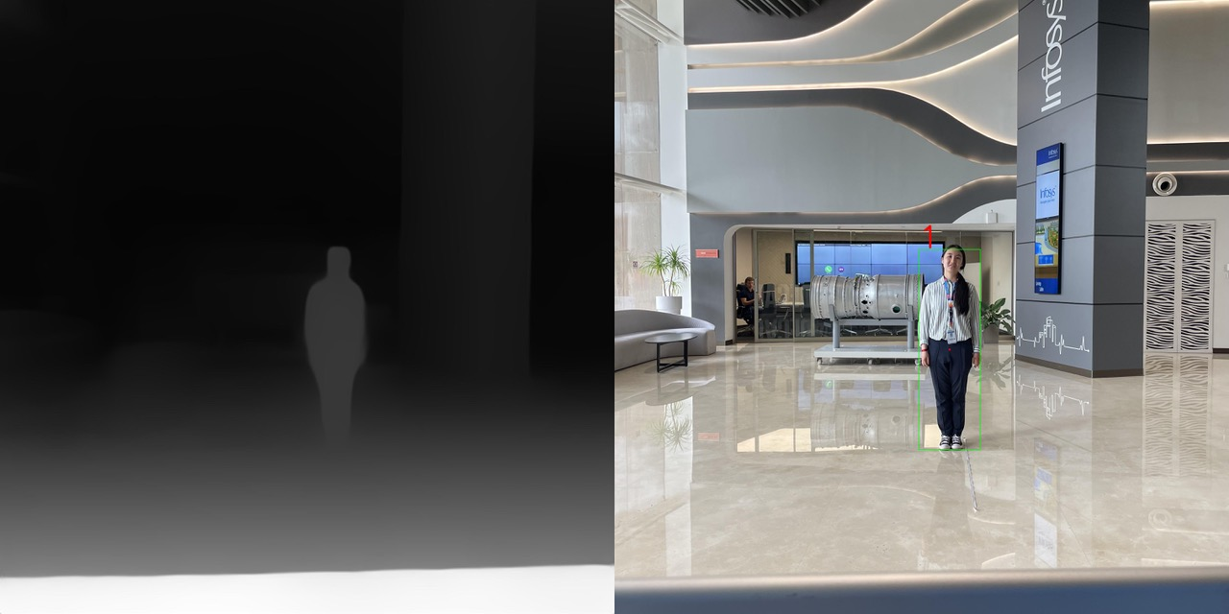
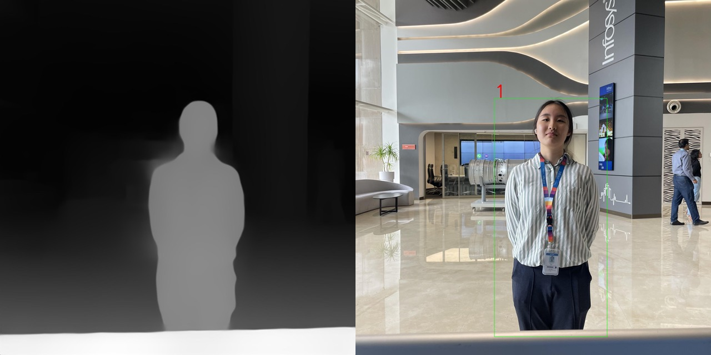
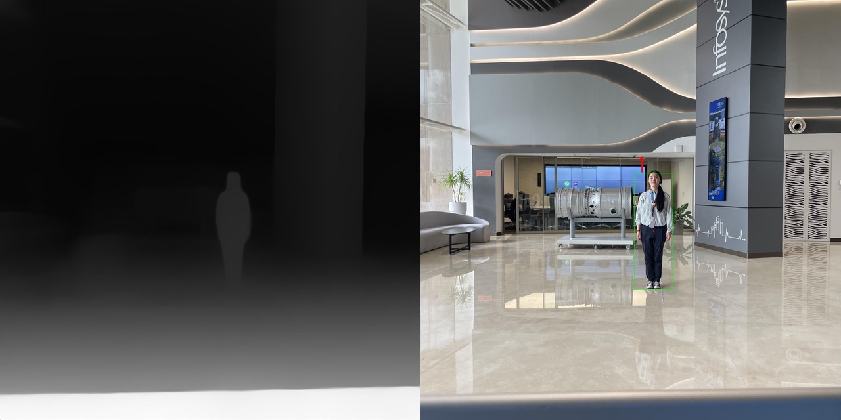
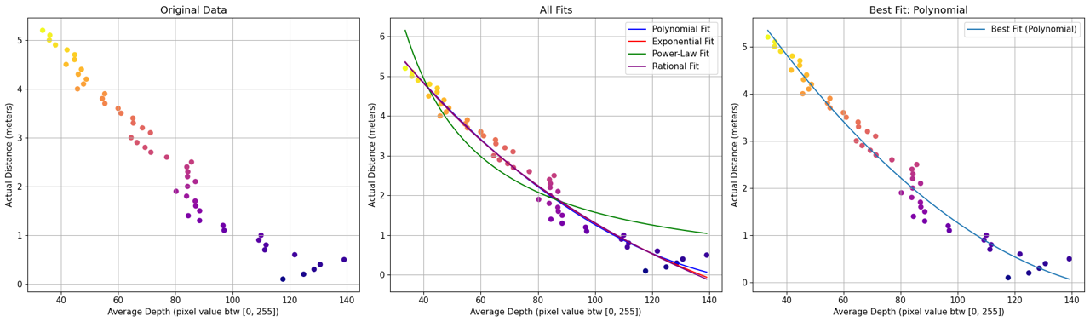
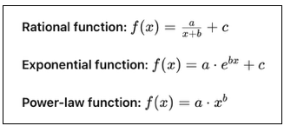
2.1 Calibration step:
Goal : Find the relation between pixel value and depth
Placed a physical reference 30 cm away
Used labeled images
Plot all the points
Find the best fitting curve
Notes:
paul

Slide 9
2.2 Depth Calculation:
Goal : Find the depth of every person in the image
1
2
3
Use the Yolov5 model to detect people
Remove the background
Do the mean of pixel value
  After this step, we are able to mark red dot at center of person to mark their x, y pixel values for top down map
Find the depth with the curve
Notes:
paul

Slide 10
3. Person Orientation:
Goal : Find the orientation of each person
Use of our own SVM model:
  Trained with our own small dataset (500 images)
  74.76 % accuracy
Feature Vector:
[scaled upper body keypoints (eyes, nose, shoulders, hips), mean angles of each pairs of keypoints, depth]
Output:
Angle in degree: [0, 45, 90, 135, 180, 225, 270, 315]
Notes:
amanda

Slide 11
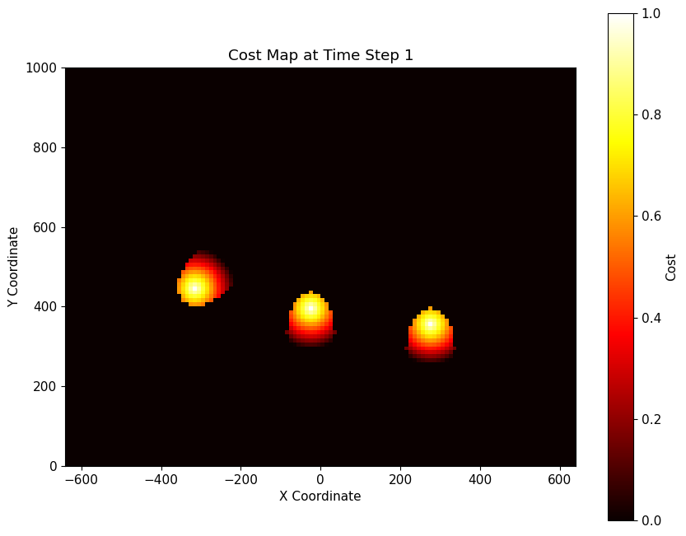
4. Cost Map
Represent to top view of the environment
X = horizontal position
Y = depth
1 unit = 1 cm on the scale to the right
The cost map is a grid where :
Each cell as a probability
It’s the probability of an obstacle being there
Our obstacles are only moving human:
Ellipse shape
Probability decreasing along a circle from the center
Notes:
amanda

Slide 12
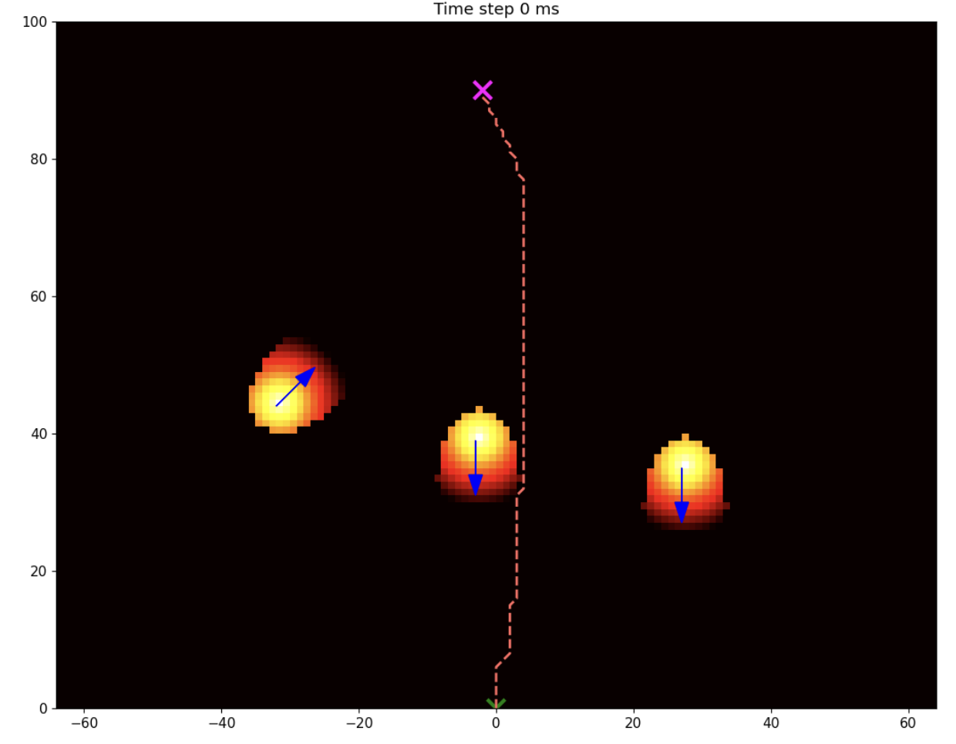
5. Navigation Algorithm
We are using a probabilistic A* to navigate through the environment
  Our cost map uses a heuristic that integrates both distance from dynamic objects and the probability of collision with the object.
    Heuristic = euclidean distance between two points
  1 unit = 0.1 cm on this shrunk down map
Notes:
maan

Slide 13
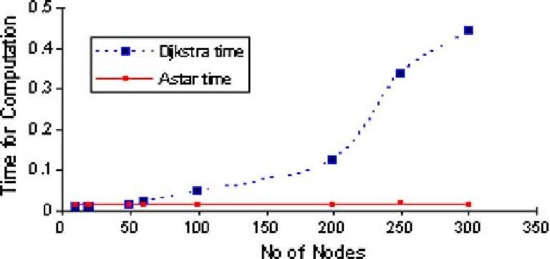
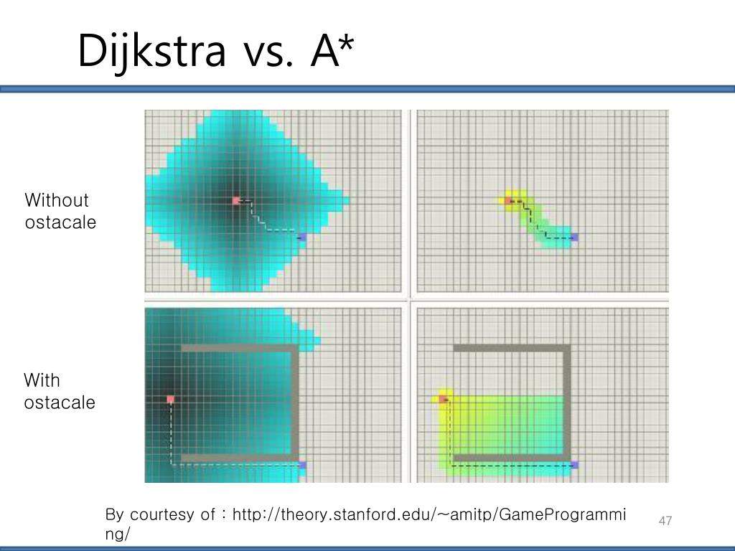
Navigation Algorithm Decision
Why A*?
  Faster than Dijkstra
    Dijkstra explores all nodes. A* chooses not to prioritize higher cost neighbor paths.
Possible future comparison explorations:
  Dijkstra: Takes more time. Only considers cost from start node to N.
  D*: Categorizes paths to come back to if cost decreases. Most promising thing to research/integrate in the future.(Not that much data on time)
Notes:
maan

Slide 14
6. Simulation
Goal : Find the optimal path while avoiding all obstacles
Start with cost map at time t
Apply A*
Update position of the robot
Update position of the Obstacles
dt
t
Cost Map at time t=0
(current)
Notes:
paul

Slide 15
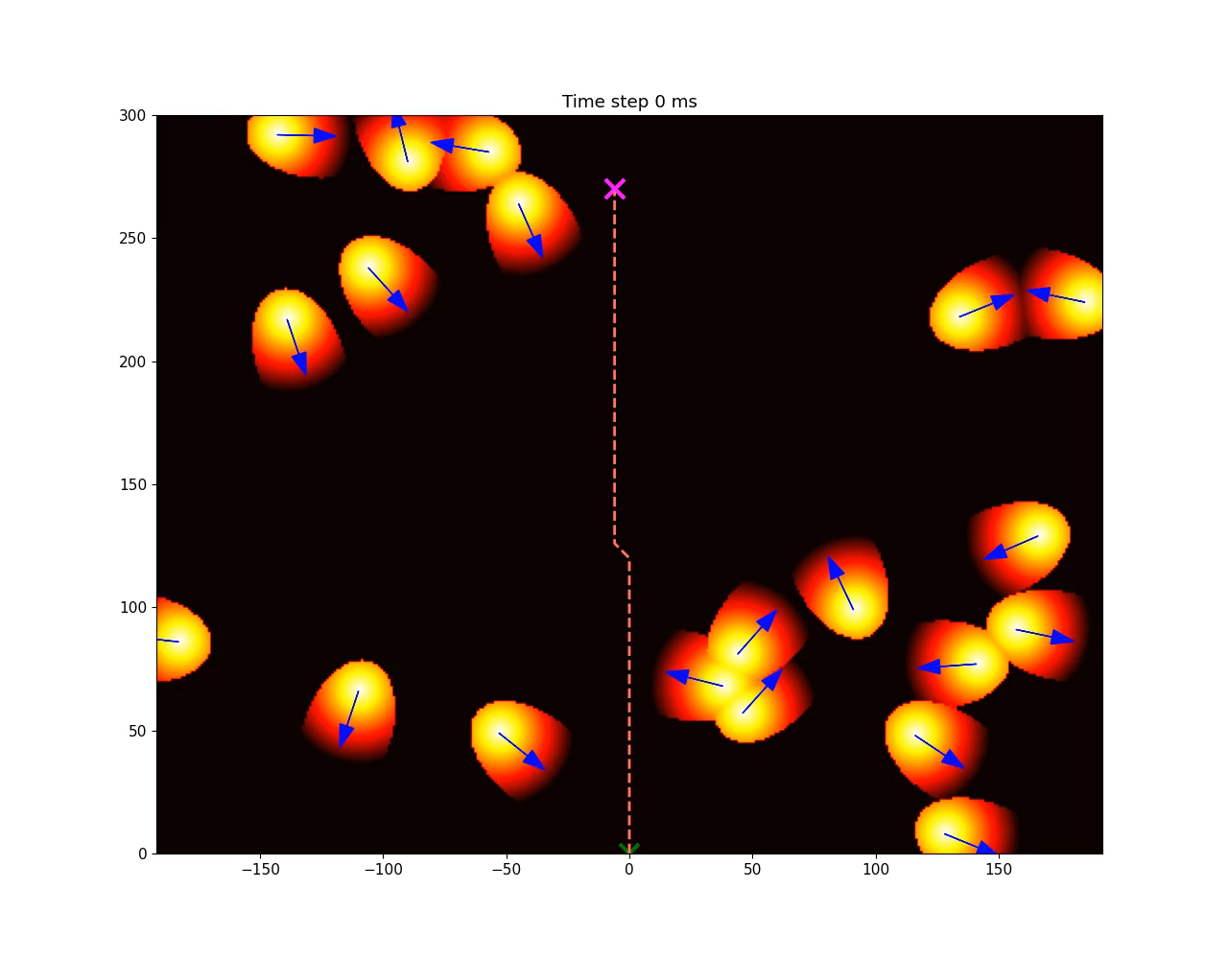
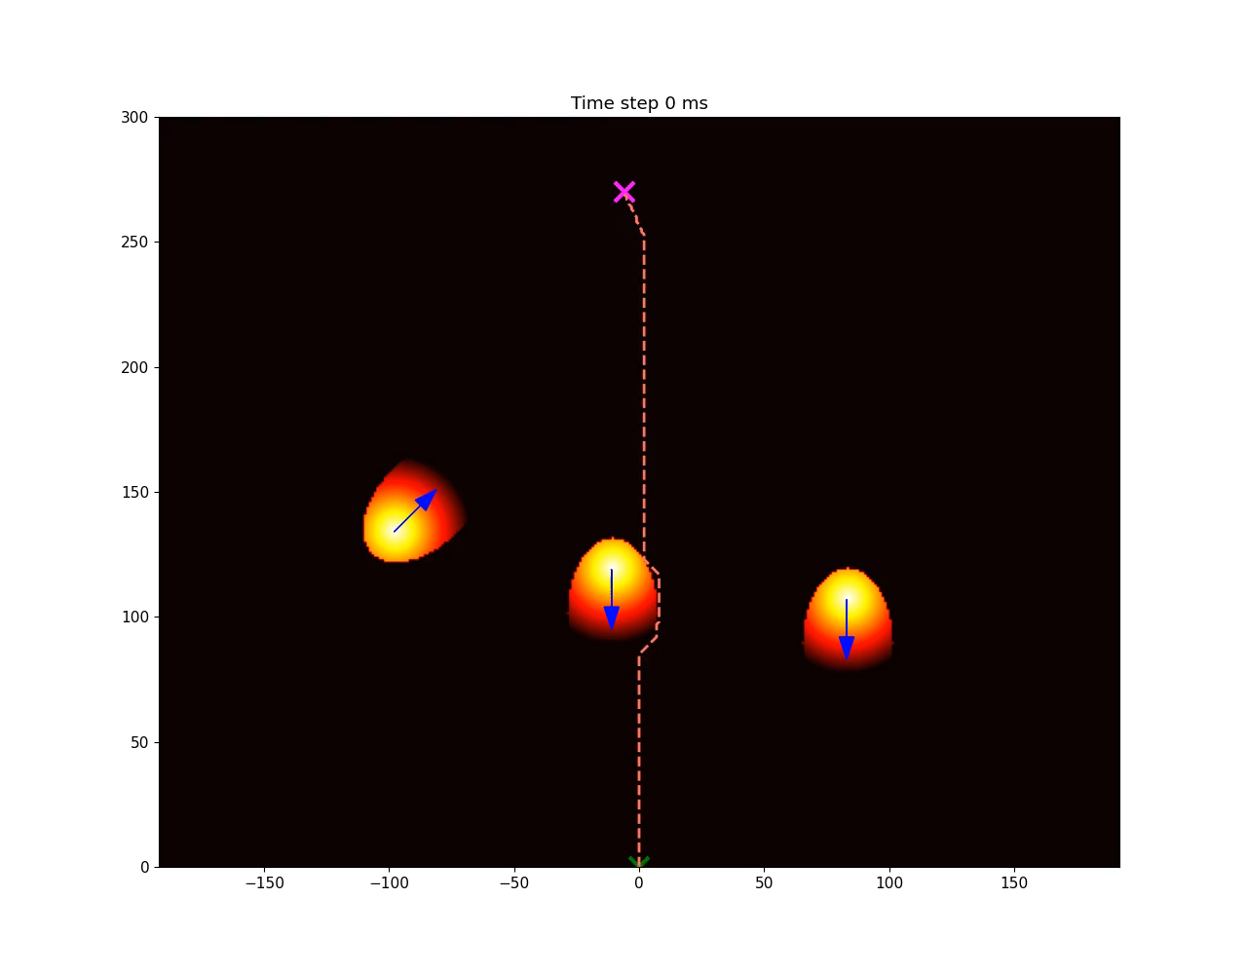
5. Simulation
You can choose:
The resolution of the grid
The time between 2 updates
The simulation time
Can work independently
  Can generate random obstacles
Notes:
paul

Slide 16
Putting it all Together
Input
Graphical output
Notes:
amanda

Slide 17
Way Forward and Next Steps Pt 1
  Use a depth camera
    Integrate depth inputs into our inputs for accurate x position and y depth position so no need for depth calibration step of our code anymore
  Integrate our simulation with real time images to simulate camera readings
    Integrate continuous data input into the simulation
    Consider A* with non-predictive obstacle positions and see if A* is able to provide paths around the obstacles
    Develop the Speed algorithm: Exploration
      Given video, and taking multi-frame inputs(perhaps the simulation is regenerated every 2 seconds, we can take 20 screenshots) to predict speed
      Or take that center keypoint that we use for plotting obstacle position and tracking it across video to predict speed
  Reduce the computation time:
    Use Numpy to replace the for loop
    Find the best set of simulations parameters (time between two updates, scale factor)
Notes:
amanda

Slide 18
Way Forward and Next Steps Pt 2
  4. Exploration of more optimal models for direction distinction and path finding.
    Direction Models
      Train a model that can provide the direction the person obstacle is facing with angle between 0 and 360 degrees.
      Areas of possible exploration:
        MLP: multi-layer perceptron, Decision Trees
    Path Finding Algorithms
      Option 1: Modify current A*
        Implement time-based A*: Take into consideration future predictive location of obstacles before that time step is reached. Current model only takes into consideration current location of obstacles.
      Option 2: Explore alternative heuristics
        Beyond Euclidean distance: Ex: Chebyshev Distance metric, compare with more complex heuristics that take into account obstacle locations, add penalty for moving backwards away from goal position
      Option 3: Compare and time the different navigation algorithms
        Options to consider: D*, Dijkstra
Notes:
amanda

Slide 19
Code Resources
  Heuristics: Heuristics (stanford.edu)
  Posenet PyTorch: rwightman/posenet-pytorch: A PyTorch port of Google TensorFlow.js PoseNet (Real-time Human Pose Estimation) (github.com)
  YOLOv5: ultralytics/yolov5: YOLOv5 🚀 in PyTorch > ONNX > CoreML > TFLite (github.com)
  Thanks to Nahas, Yathisha, Victor, Shivakumar, Ravi for all the help and guidance in each update meeting
Notes:
amanda

Slide 20
THANK YOU

Slide 21
Roles
All | Amanda | Maan | Paul
Research and installation of all the library Creating sample data images Brainstorm for the overall project Workflow Presentation Slides | A* Research Researching new heuristics to optimize A* algorithm, Initial A* exploration. | Posenet A* Research Working on scaling and optimizing simulation so it runs more optimally. | Project Pipeline Calibration Algo Cost map calculations Simulation Algo Direction model.

Slide 22
3. Person Orientation Part 2: SVM
Why train our own model?
  No model with the right licensing exist
Why SVM?
  Works on nonlinear dataset
  Works on highly dimensional feature space of the Posenet keypoints and angles between keypoints
  Large margins between classes (giving us higher and more precise accuracy)

Slide 23
3. Future Explorations of Person Orientation Models
  Multiple Layer Perceptron(MLP)
    More complexity = better separation of classes
    Concern: overfitting and need larger datasets if we want to have even more angles available
  Decision Trees
    No need for normalization of features(features don't influence each other)
    Concern: overfitting if tree is too deep

Slide 24
Challenges Faced
Figuring out which part of the simulation was taking so long
  Map too large, computationally expensive to be rendering entire grid at every simulation step
  Solution: scale down the map, less precise but much faster. Went from 40 minutes down to 2 minutes
Finding speed of dynamic objects
  Given current setup, we are taking static images, but in the real world application it would be webcam so the object positions are constantly changing
  Idea: we calculate the A* and cost map every 2 seconds, but we can take about 20 static images within those 2 seconds that can help to calculate the speed of each human

Slide 25
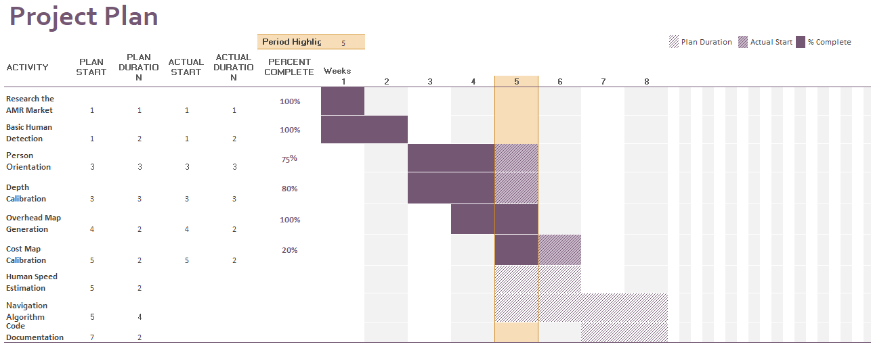
Agenda
*Week 5: M-W Mysore Excursion, Week 6: Th-F and Week 8: M National Holiday

Slide 26

Agenda and End Objective
Week 5:
M-W: Mysore excursion, visit the facilities and see the robot
Research speed estimation and linear method cost maps.
Week 6: (Th, F long weekend)
Research and implement speed estimation with YOLOv5 since it isn’t built in
Calibrate a cost using linear method for fixed images
Week 7:
Integrate the cost with speed estimation to generate cost map
Week 8:
Wrap up coding and document the installation and code transfer to team
Not sure if we’ll be able to get to the 4th objective with navigation using the cost map. Depends on how long the integration will take in Week 7.

